Slide 1
Precision Tests of Discrete Symmetries with Trapped Neutrons
Discrete Symmetries in Particle Interactions
Neutron trapping -> Ultra-Cold Neutrons (UCN)
Probing large Parity violation in Electroweak Interaction
Precision study of neutron β-decay
Virtual particle corrections access high mass scales
Searching for very small Time-Reversal (CP) Violation
Via neutron Electric Dipole Moment (EDM)
B. Filippone
Ph242
2/15/19
Notes:
It’s great to be back in Philly. I actually grew up about 4 mi from here in Overbrook. Also went to Eagles Games in across the street at Franklin Field

Slide 2
UCN Group @ Caltech
Undergrads
Morgaine Mandigo-Stoba, Tine Valencic
Grads
Marie Blatnik, Xuan Sun, Eric Fries
Postdocs
Simon Slutsky, Chris Swank
Research Engineer
Wanchun Wei
Technician
Bob Carr
Visiting Faculty Associate
Roy Holt
Faculty
BWF

Slide 3
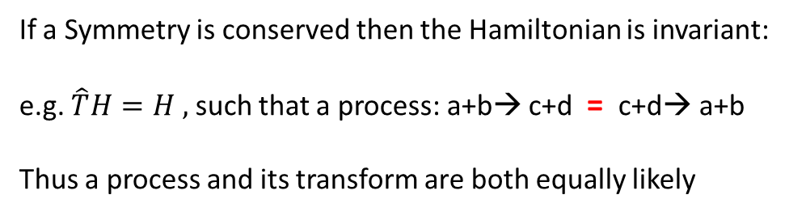
Discrete Transformations & Symmetries
Transformations:
Charge Conjugation
Parity
Time Reversal
Symmetries:
If a Symmetry is conserved then the Hamiltonian is invariant:
e.g. $\hat{T}H=H ,$ such that a process: a+b→ c+d = c+d→ a+b
Thus a process and its transform are both equally likely

Slide 4
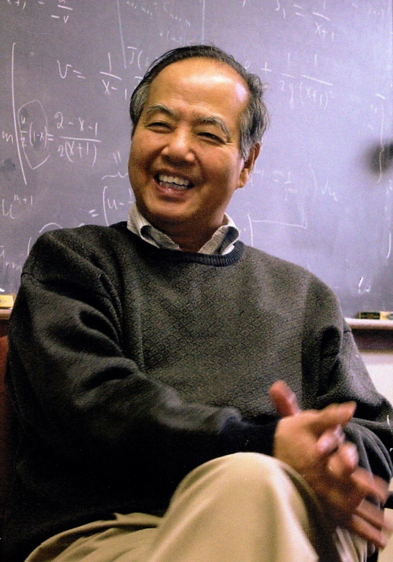
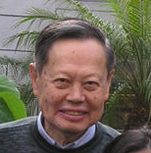
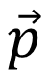
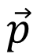
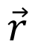
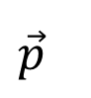
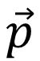
Example 1: Parity Violation in the Electroweak Interaction
T.D. Lee
C.N. Yang
Consider beta-decay of polarized neutron
Polarization = spin = axial vector →
$$\vec{r}$$
x
$$\vec{p}$$
Polarized neutron
e
e
$$\vec{p}$$
$$\vec{p}$$
e
e
If this experiment ≠ this experiment
then Parity is not Conserved
$$\vec{p}$$
Which implies N_{e} = 1 + α cosθ
α = asymmetry
e
θ
spin

Slide 5
Experimental Confirmation of Parity Violation
⁶⁰Co Decay
C.S. Wu, R.W. Hayward, D.D. Hoppes, R.P. Hudson
Phys Rev 105, 1413 (1957)
μ⁺ Decay
R.L. Garwin, L.M. Lederman, M.Weinrich
Phys. Rev. 105, 1415 (1957)
α ~ -0.2 ± 0.02 → a “10σ” measurement
α = -0.33 ± 0.03 → a “10σ” measurement

Slide 6
Why is Precision Parity Violation Interesting?
Thanks to my theorist friend - Vincenzo Cirigliano (Los Alamos) for this slide

Slide 7
E.g. Consider Neutron Decay
Quark weak coupling in Standard Model contained in V_{ud}
(from μ vs n-decay)
New particles produce loop corrections
μ⁻
ν_{μ}
d
g_{W}V_{ud}
u
g_{W}
W⁻
e⁻
W⁻
e⁻
ν_{e}
ν_{e}
μ⁻
~
ν_{μ}
d
~
u
χ⁰
χ⁰
~
~
~
~
μ
ν
d
u
e⁻
W⁻
e⁻
W⁻
Note: Z⁰ Boson changes Standard Model neutron lifetime by 2%
(present uncertainty < 0.5%)
ν_{e}
ν_{e}

Slide 8
Example 2: Time Reversal Violation in EDM
EDM for neutron or electron or proton implies a violation of Time Reversal Invariance because …
This implies four distinguishable neutrons:
spin up, EDM up
spin down, EDM up spin up, EDM down
spin down, EDM down
Both states should exist if Time Reversal Symmetry is respected
But only two distinguishable neutron states exist!! (Pauli Principle)
→ Time Reversal Symmetry is violated

Slide 9
Quantum view of T-Violation
123
123
P
T
P-even
T-even
P-odd
T-odd
μ
+
-
d
+
-
E
-
+
Non-zero d violates both T, P
Note: CPT Theorem of Quantum Field Theory says C x P x T is conserved
Thus: non-zero d also violates CP
B
+
-
J
+
-

Slide 10
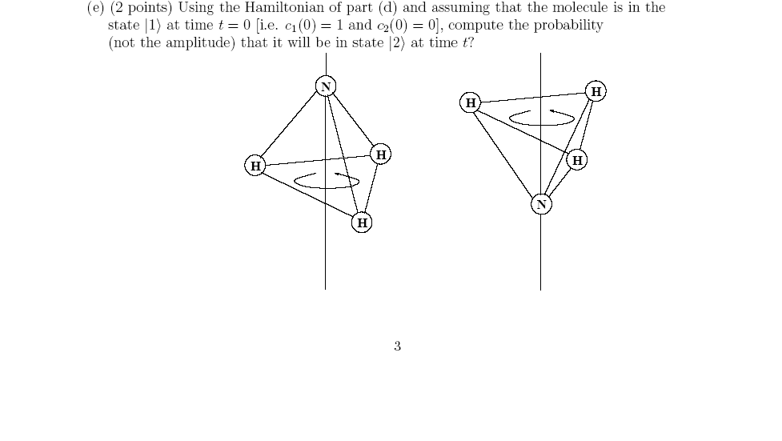








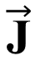
What about HUGE Molecular EDMs!
H₂0: d = 0.4 x 10⁻⁸ e-cm
NaCl: d= 1.8 x 10⁻⁸ e-cm
NH₃: d = 0.3 x 10⁻⁸ e-cm
$$\vec{\text{J}}$$
$$\vec{\text{J}}$$
But NH₃ EDM is not T-odd
or CP-odd since
$$\vec{\text{d}}$$
$$\vec{\text{J}}$$
$$\vec{\text{d}}$$
$$\vec{\text{d}}$$
$$\vec{\text{J}}$$
$$\vec{\text{J}}$$
$$\vec{\text{d}}$$
Ground state is actually a
superposition

Slide 11
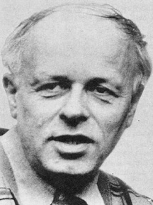
Why is CP Violation Interesting?
http://scienceworld.wolfram.com
Sakharov Conditions (1967)
Total number of quarks must change
- Possible in Standard Model in Big Bang
Departure from Thermal Equilibrium
- Phase Transitions can do this
CP & C violation
- Weak interaction violates C & CP
- But CP violation in the Standard Model is TOO small
A. Sakharov
New particles/interactions are needed to provide larger CP violation → EDMs may be evidence for this

Slide 12
Baryogenesis
Plausibility Argument
Consider heavy boson - X
Baryon number violation:
C-Violation & CP-Violation
Out of Thermal Equilibrium
Otherwise, in Equilibrium the reverse reactions:
(e.g. )
will smooth out any matter/antimatter excess

Slide 13
Electroweak Baryogenesis
Possible source of Matter-Antimatter Asymmetry
Before Electroweak Phase
Transition
After EW Phase
Transition
Today
Non-equilibrium
10¹⁰
N
0
γBB
γBB
γBB

Slide 14
Neutron EDM & New Physics
Small EDM in standard model (CKM) provides negligible “background” signal
New CP violation “natural” in new physics
e.g. d_{n} ~ 10⁻²⁵ e-cm x sinϕ_{CP}(1 TeV/M_{BSM})²

Slide 15
How to Use UCN to Search for New Physics
Precision measurements of neutron decay
Parity Violation
Search for non-zero neutron EDM
But first …
What are UCN and do we make them??

Slide 16
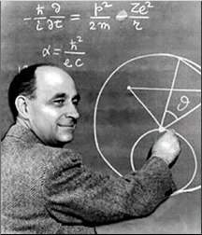
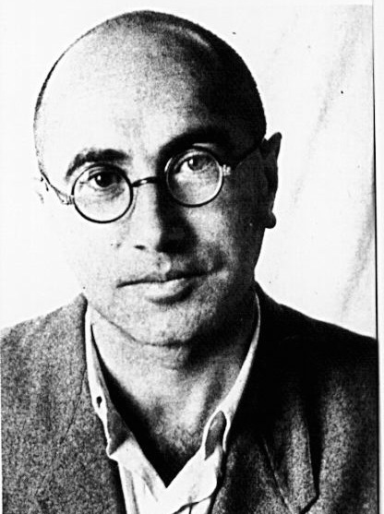
Ultra-Cold Neutrons (UCN) (Fermi/Zeldovich)
Very slow neutrons
(v < 8 m/s , λ > 500 Å )
that cannot penetrate into
certain materials
Neutrons can be
trapped in bottles
or by magnetic
field ( ≤ 7 T)

Slide 17
But… nuclear force is attractive at low
energies.
Where does repulsion come from?
Recall (for short-range potential):
At low energies (kr₀<<1; eg s-wave) elastic scattering determined solely by scattering length a
For k 0
σ_{elas} = 4πa²

Slide 18
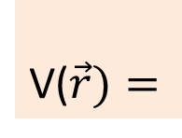
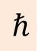
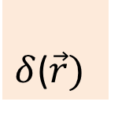
Scattering Length
Repulsive Potential
Weak Attractive Potential
Strong Attractive Potential
Same !
Thus many different V₀ and r₀ can give same a
→ Fermi
V($\vec{r})=$
$$ℏ$$
$δ$($\vec{r})$

Slide 19
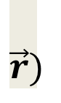
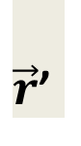
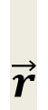
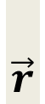
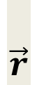
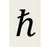
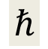
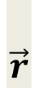
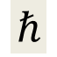
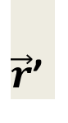

Fermi Pseudopotential
$$\vec{r})$$
$$\vec{r}$$
$\vec{r}$’
$$ℏ$$
Then for many nuclei in a solid:
$$\vec{r}$$
$$\vec{r}$$
$\vec{r}$’
And if a_{i} = a and
λ >> atomic spacing:
$$ℏ$$
$$\vec{r}$$
$$\vec{r}$$
$$ℏ$$
n₀ is the number density
Effective Step Potential

Slide 20
Effective Potential Step
E_{UCN}
The coherent nuclear potential can lead to repulsive pseudopotential for a > 0
For E_{UCN} < V₀, UCN are trapped
Attractive potential can also lead to neutron absorption
but often L_{mfp} >> λ_{n} (~10⁻⁵ probability per bounce)

Slide 21
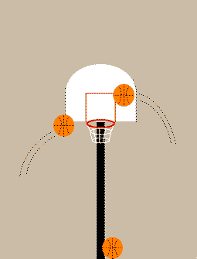
UCN Properties
g
3m
UCN

Slide 22
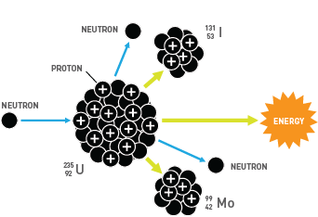
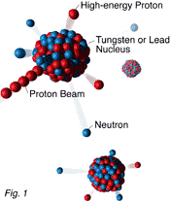
How to Produce Free Neutrons
Reactors via Fission
Accelerators via Spallation
~ 2-3 neutrons/fission
Protons
Neutrons
Tungsten Nucleus Target
~ 20 neutrons/spallation
for 800 MeV proton beam
Proton Beam
Secondary Neutrons

Slide 23
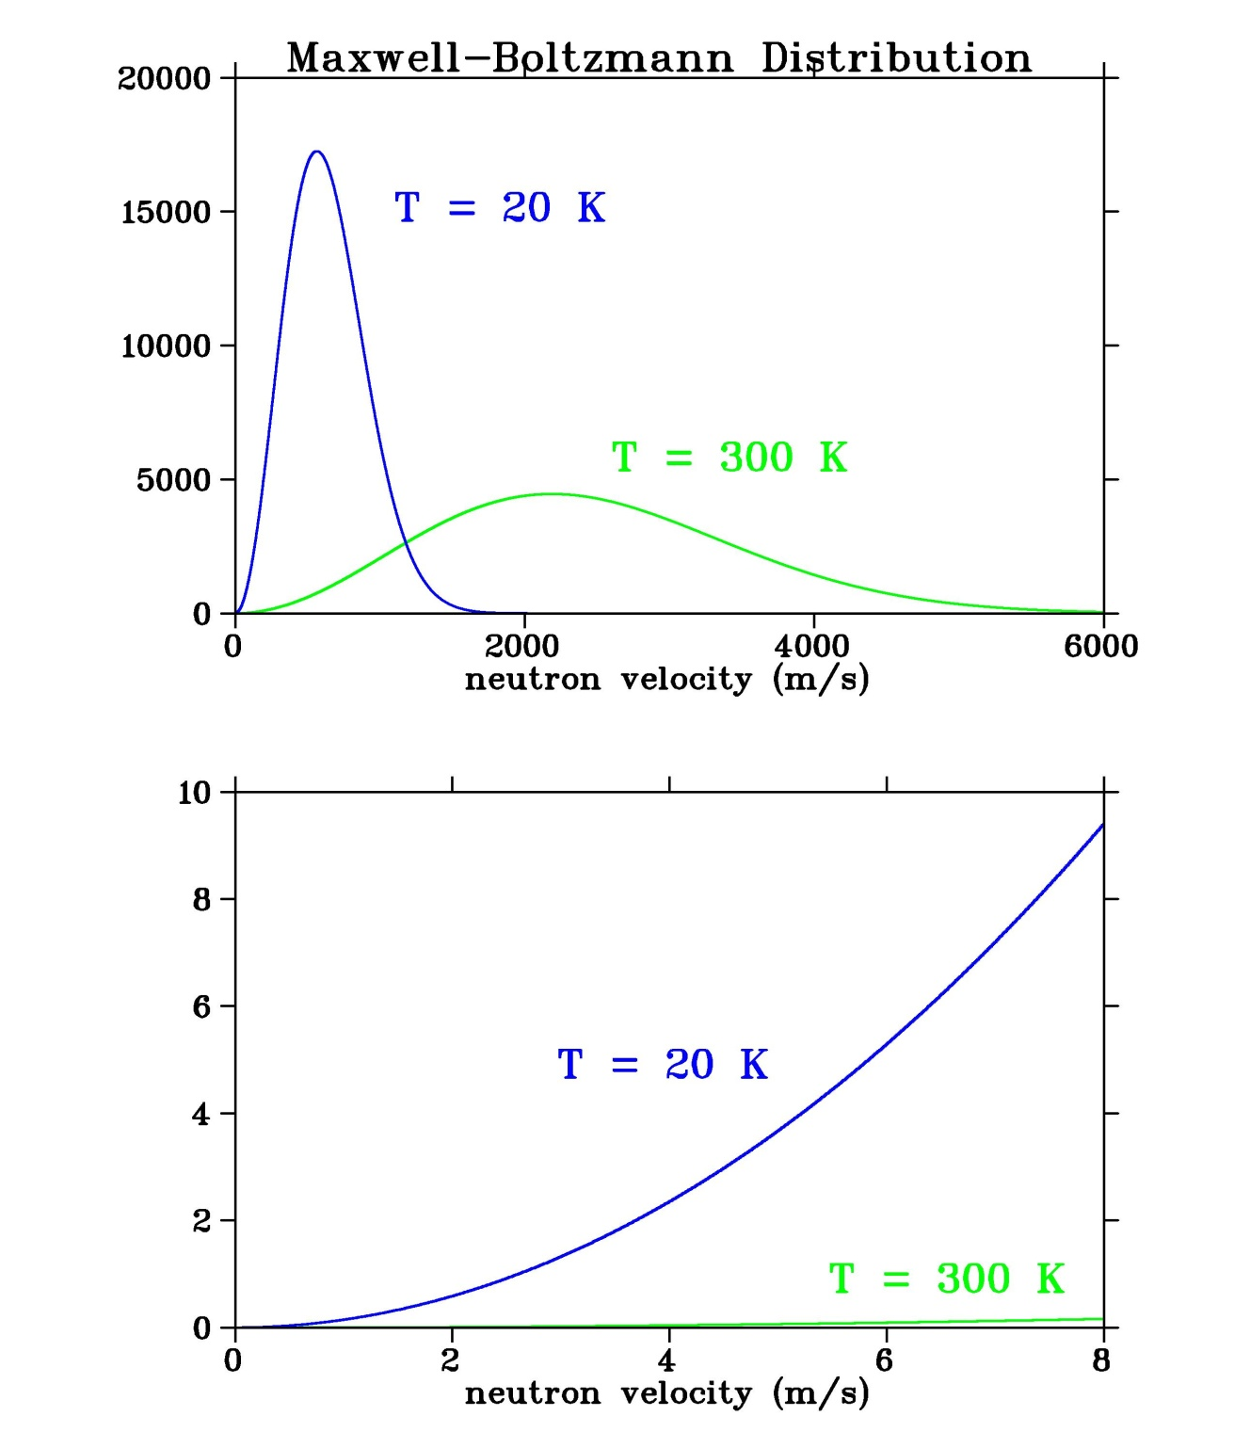
Thermal Sources of Free neutrons
Only small fraction of distribution is UCN

Slide 24
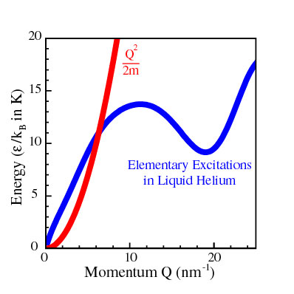
Superfluid ⁴He
Solid deuterium (SD₂)
Developed at Los Alamos Natl. Lab
Small absorption probability
Fast UCN production
Small Upscattering if T < 6K
New High Density UCN Sources
(neutron)
λ ~ 1nm (~11K) incident n
produces phonon &
becomes UCN
Very few 11K phonons if T < 1K
minimal upscattering

Slide 25
Neutron Beta Decay
or in quark picture…
u
d
p
u
u
d
e⁻
d
W⁻
ν_{e}
n

Slide 26
Neutron Differential Decay Rate:
⎛
r
r
r
r
r
r
⎞
p
.
p
σ
.
p
σ
.
p
m_{e}
d
Γ
=
Γ
f_{phase}
⎜
1
+
a
e
ν
+
A
n
e
+
B
n
ν
+
b
⎟
n
⎜
_{space}
⎝
E
E
E
E
E
⎠
e
ν
e
ν
e
Γ_{n} = 1/τ_{n} is total decay rate
a, A and B are decay correlations (e.g. spin-momentum)
- In Standard Model they depend only on two coupling constants: g_{A} (axial-vector) and g_{V} (vector)
b is the Fierz interference term
- Beyond-Standard-Model scalar & tensor coupling
To determine g_{A} and g_{V} must measure two quantities
→ e.g. τ_{n} and A
(Neutrino correlations use proton kinematics)

Slide 27
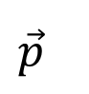
g_{A}/g_{V} from parity violating e⁻-asymmetry in polarized neutron decay
e⁻ Asymmetry with UCN = UCNA
$$\vec{p}$$
e
θ
spin

Slide 28
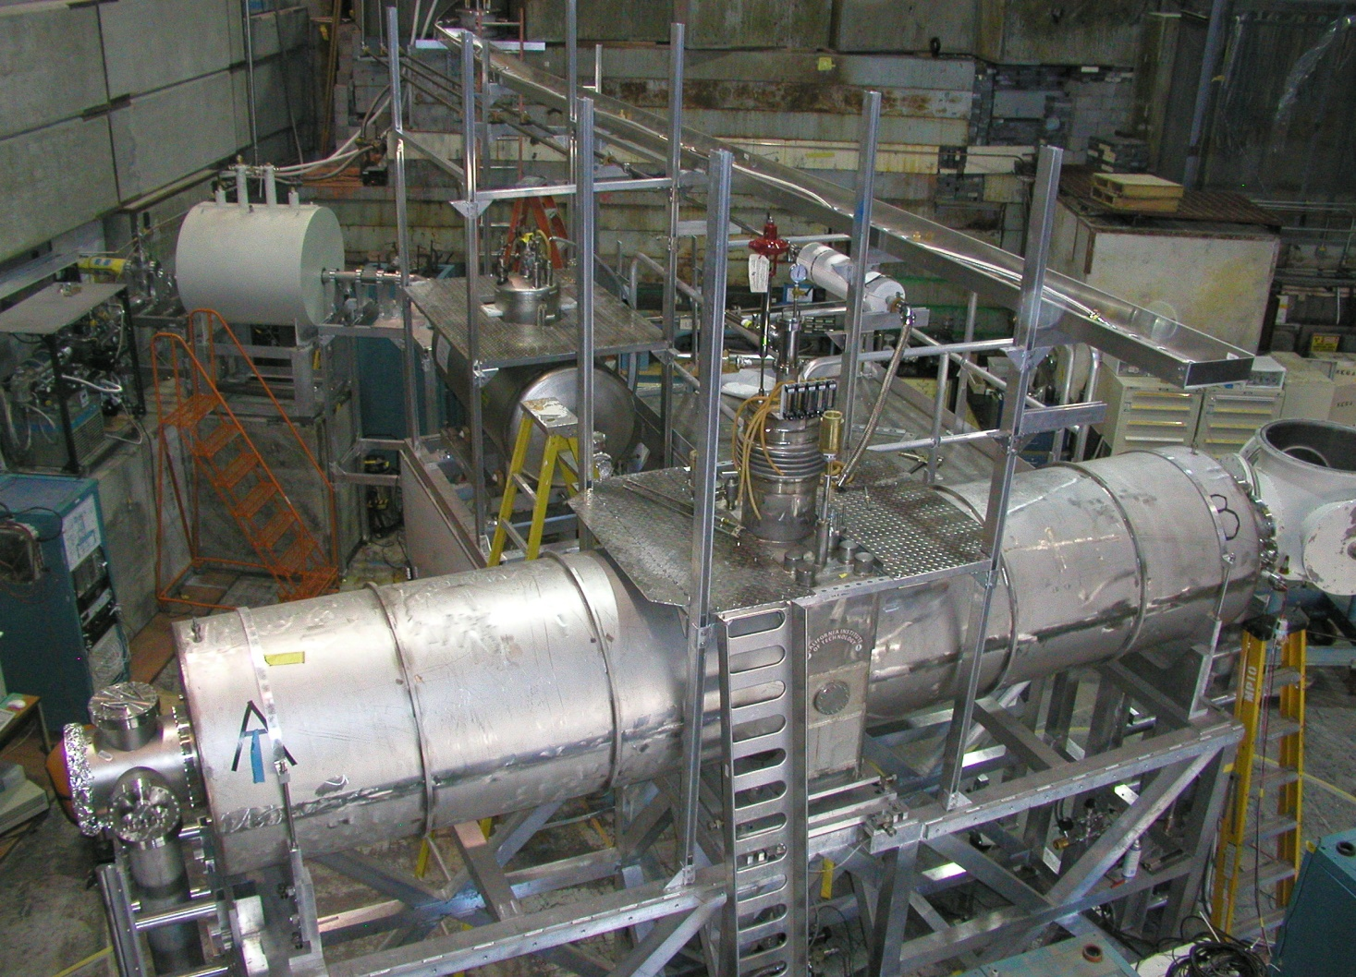
UCNA experiment First to study neutron decay properties with UCN
UCN source at 5K + 3 superconducting magnets at 4K
Liquid N₂
Be reflector
LHe
Solid D₂
77 K poly
Tungsten Target

Slide 29
New result for the neutron β-asymmetry parameter A₀ from UCNA
M. Brown et al. (UCNA Collaboration), Phys. Rev. C 97, 035505 (2018)
Note: this is a 250σ measurement of Parity Violation

Slide 30
New UCNτ Experiment
Magnetic/Gravitational UCN Trap
Marginally trapped UCN are pre-cleaned
UCN are stored for up to 1.5 hr

Slide 31
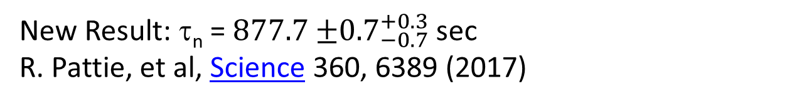
Active dagger detector “terminates” the stored UCN
New Result: τ_{n} = $877.7{±0.7}_{−0.7}^{+0.3}$ sec
R. Pattie, et al, Science 360, 6389 (2017)

Slide 32
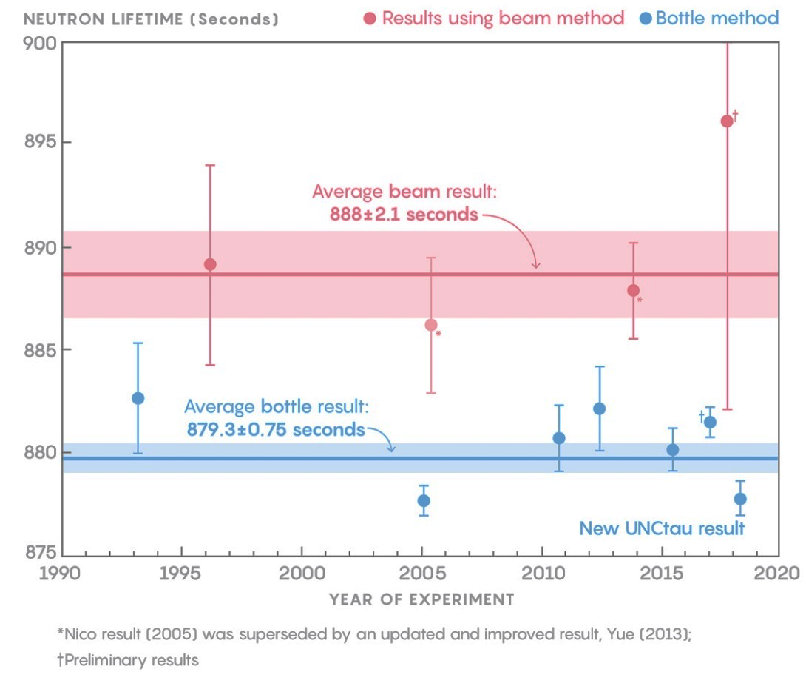
Neutron Lifetime “Puzzle”
Beam result -> Measures # of produced protons
Bottle result -> Measures # of surviving neutrons for different storage times
So there must be some unknown systematic error in one of the techniques? Or …
Lucy Reading-Ikkanda/Quanta Magazine;
Source: pre-2017, Particle Data Group;
Serebrov 2017, arxiv:1712.05663;
Pattie, 2018, arxiv:1707.01817

Slide 33
What if instead of just:
n → p + e⁻ + ν_{e}
We could also have (just 1% of the time):
n → χ + γ
→ χ + e⁺e⁻
→ χ + ν
−
Where χ is a new Dark Matter particle

Slide 34
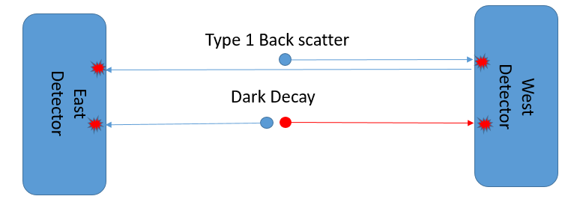
How do you Search for New Physics Quickly?
(You already have the data!)
Electron Backscattering from Neutron Decay
Neutron Dark Matter Decay

Slide 35
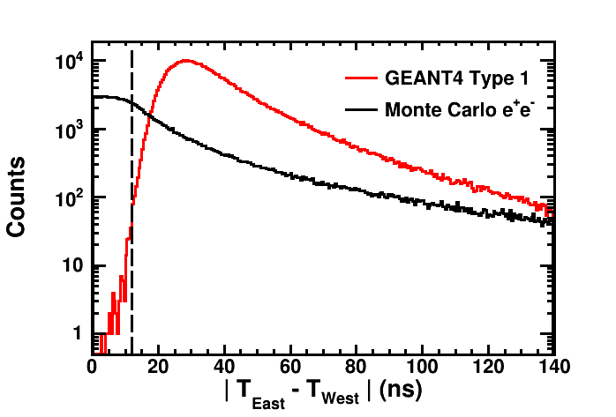
Simulate the Two Processes (2 weeks)
1% dark matter decay branch
GEANT4 Backscattering

Slide 36
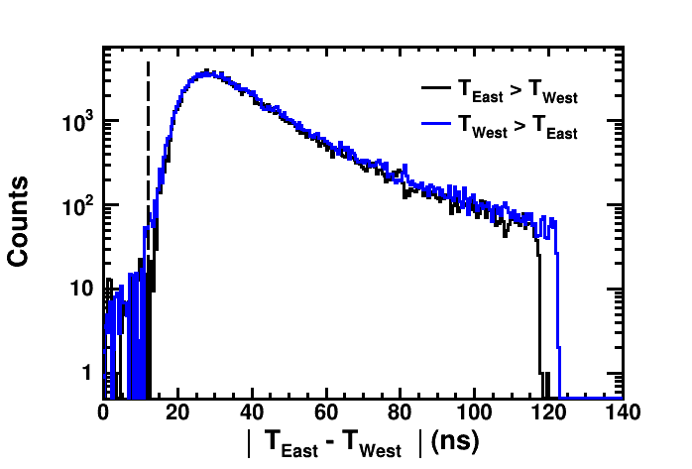
Analyze the Data (5 weeks)

Slide 37
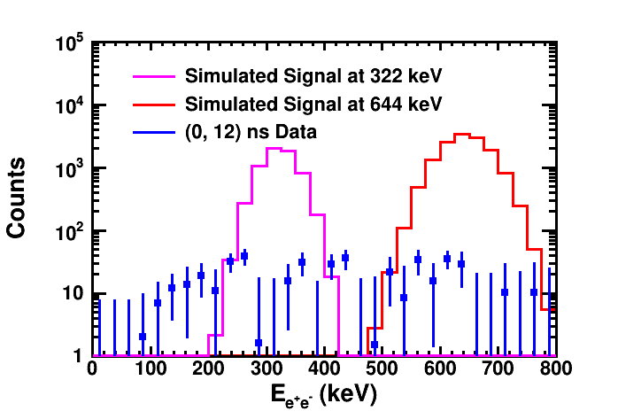
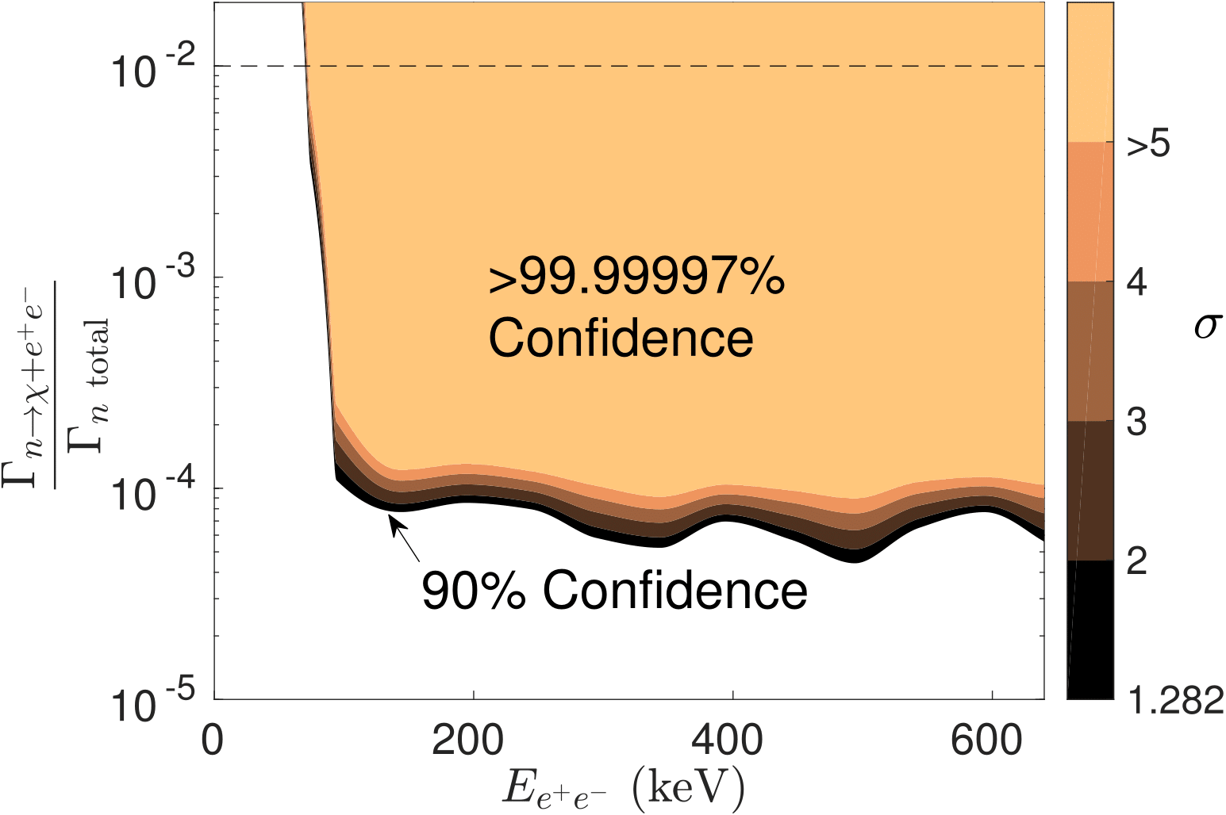
Determine Upper Limits and Write Paper (2 weeks)
1% dark matter decay branch

Slide 38
Submit Paper (1 day) Get it Published (6 weeks)

Slide 39
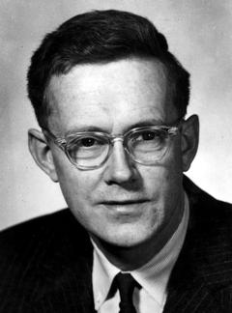
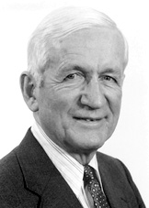
Searches for a Neutron EDM
E.M. Purcell and N.F. Ramsey, Phys. Rev. 78, 807 (1950)
Searching for Parity Violation in Neutron Scattering
Pioneered Neutron Beam Magnetic Resonance

Slide 40
EDM Measurement Uncertainty

Slide 41
How to Measure an EDM

Slide 42
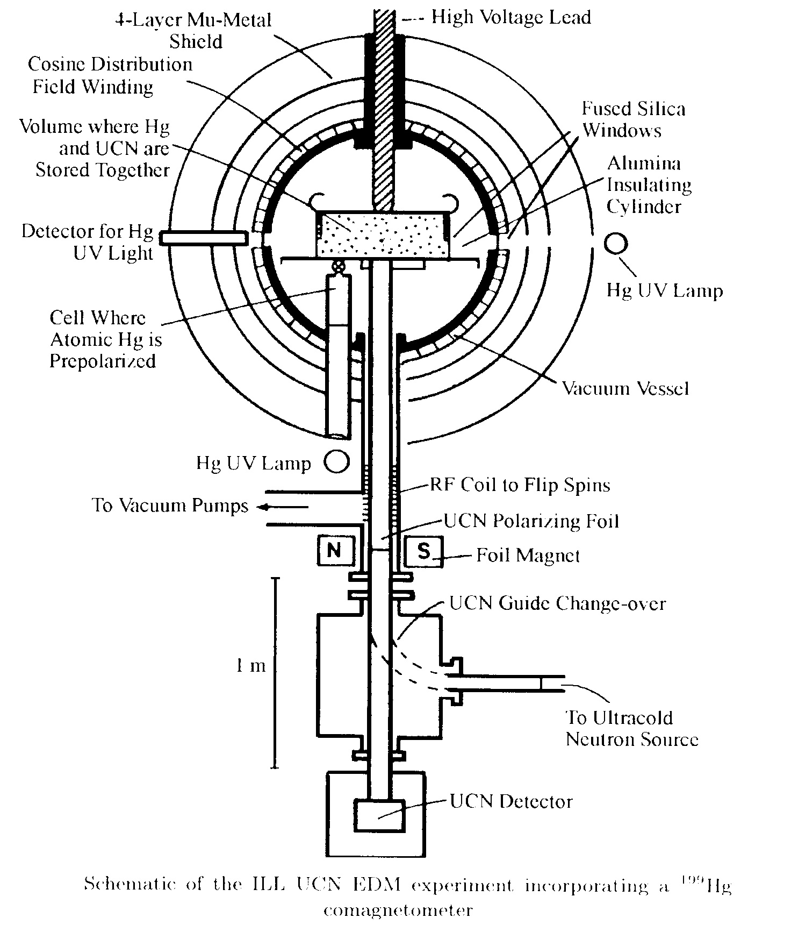
Best Neutron EDM Limit: ILL-Grenoble neutron EDM Experiment
Harris et al. Phys. Rev. Lett. 82, 904 (1999)
Baker et al. Phys. Rev. Lett. 97, 131801 (2006)
Trapped Ultra-Cold
Neutrons (UCN) with
N_{UCN} = 0.5 UCN/cc
|E| = 5 - 10 kV/cm
100 sec storage time
σ_{d} = 3 x 10⁻²⁶ e cm

Slide 43
New Searches for Neutron EDM
Enhanced number of stored neutrons
Increased electric field
Minimizing systematic effects

Slide 44
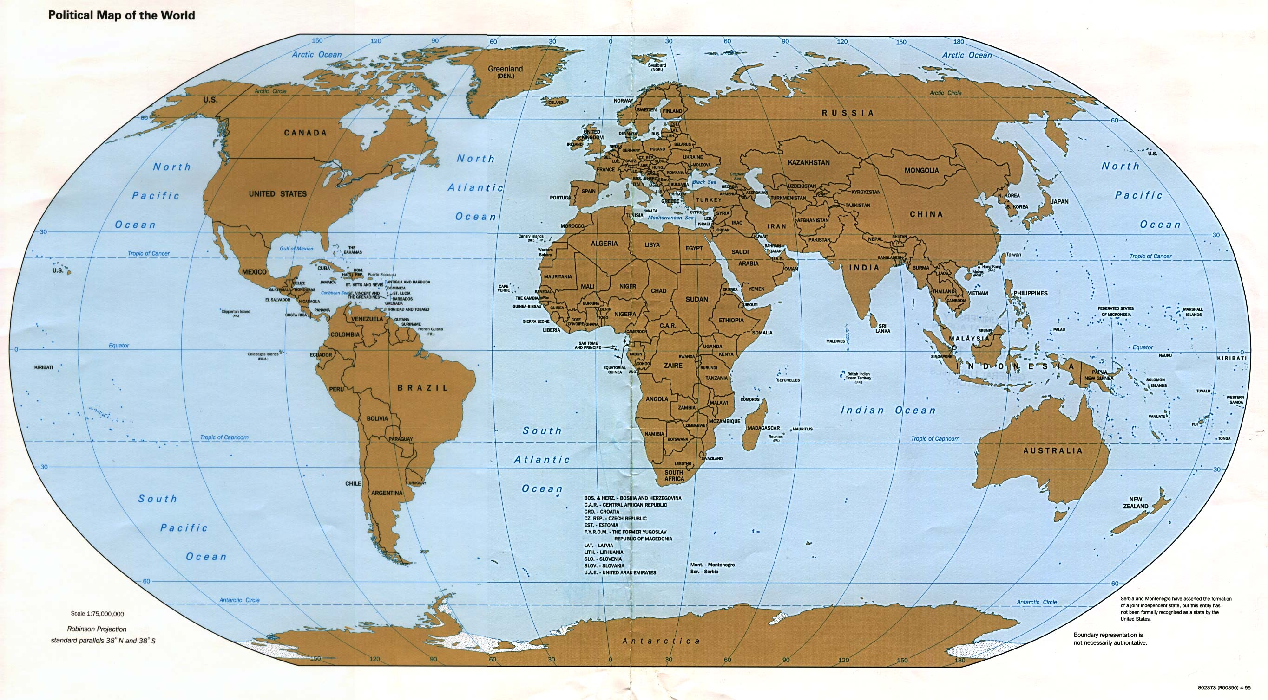
Neutron Sources & EDM Searches
TRIUMF
SNS Oak Ridge
PNPI
ILL
NIST NCNR
JPARC
FRMII
PULSTAR
NCSU
LANSCE
Los Alamos
PSI
Research Reactors
Proton Accelerators (spallation sources)
Neutron EDM Experiments

Slide 45
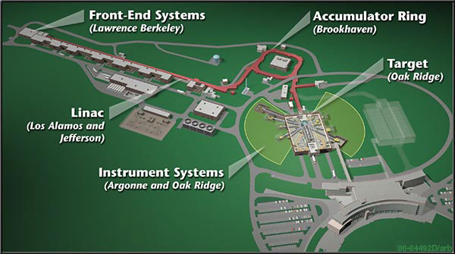

nEDM Experiment at Oak Ridge Spallation Neutron Source - SNS
Concept:
R. Golub & S. K. Lamoreaux, Phys. Rep. 237, 1 (1994)
High trapped neutron densities (SFHe)
LHe as HV insulator
Use of a ³He co-magnetometer and superconducting shield
Variation of LHe temperature to study v x E systematics
Precession frequency measurement via two techniques
Sensitivity reach: dn < 3 x 10^{–28} e-cm (in 3 calendar yrs)
“Most ambitious nEDM experiment that is currently underway”
nEDM@SNS Review Committee
Notes:
mention controlling geometric phase with temperature

Slide 46
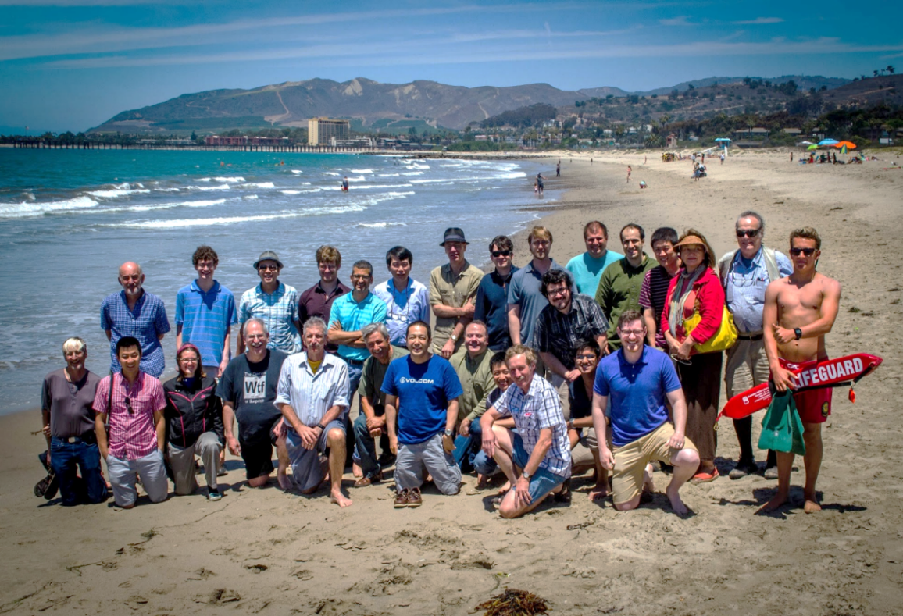
L. Bartoszek, D. Beck, C. Daurer, J.-C. Peng, T. Rao, S. Williamson, L. Yang
University of Illinois Urbana-Champaign
S. Clayton, S. Currie, T. Ito, Y, Kim, M. Makela, J. Ramsey, W.Sondheim. Z, Tang, W. Wei
Los Alamos National Lab
K. Dow, D. Hasell, E. Ihloff, J. Kelsey, J. Maxwell, R. Milner, R. Redwine, E. Tsentalovich, C. Vidal
Massachusetts Institute of Technology
D. Dutta, E. Leggett
Mississippi State University
R. Golub, C. Gould, D. Haase, A. Hawari, P. Huffman, E. Korobkina, K. Leung, A. Reid, A. Young
North Carolina State University
R. Allen, V. Cianciolo, Y. Efremenko, P. Mueller, S. Penttila, W. Yao
Oak Ridge National Lab
M. Hayden
Simon Fraser University
A. Holley
Tennessee Technological Institute
L. Barrón-Palos
Universidad Nacional Autonóma de Mexico
G. Greene, N. Fomin
University of Tennessee
S. Stanislaus
Valparaiso University
S. Baeβler
University of Virginia
S. Lamoreaux
Yale University
SNS nEDM Collaboration
R. Alarcon, R. Dipert
Arizona State University
G. Seidel
Brown University
D. Budker
UC Berkeley
M. Blatnik, R. Carr, B. Filippone, C. Osthelder, S. Slutsky, X. Sun, C. Swank
California Institute of Technology
M. Ahmed, M. Busch, P. –H. Chu, H. Gao
Duke University
I. Silvera
Harvard University
M. Karcz, C.-Y. Liu, J. Long, H.O. Meyer, M. Snow
Indiana University
C. Crawford, T. Gorringe, W. Korsch, E. Martin, N. Nouri, B. Plaster
University of Kentucky
Project Manager: V. Cianciolo
Spokesperson: BWF
Notes:
~ 80 physicists, 19 institutions,

Slide 47
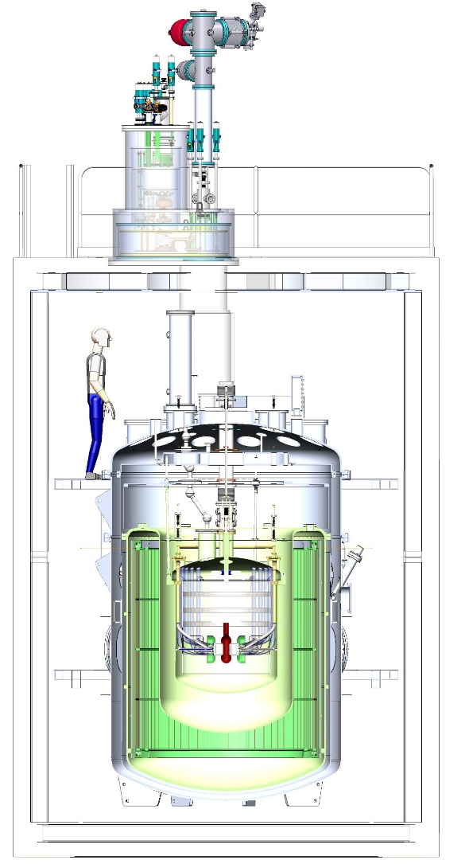
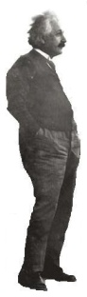
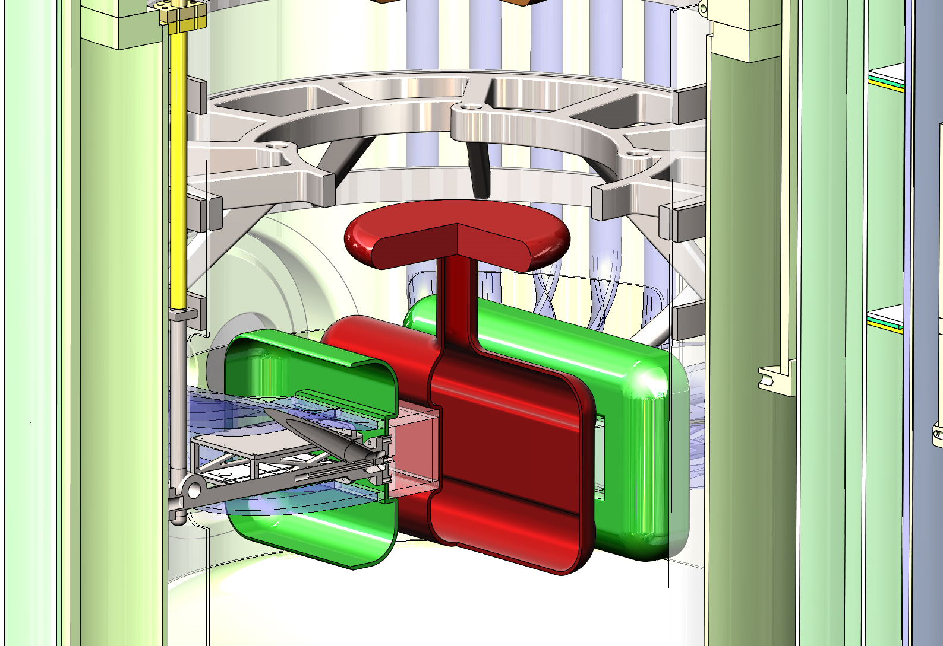
Main Experimental Components
POLARIZED 3He SOURCE
INJECTION MODULE
MAGNETIC SHIELD HOUSE
MEASUREMENT CELLS
MAGNET PACKAGE
NOTE: Neutron beam goes into page

Slide 48
New Technique for n-EDM
E-field
Inject polarized neutron
& polarized ³He
2. Rotate both spins by 90º
3. Measure n+³He capture
vs. time
(note: σ_{ih}>>σ_{hh})
n + ³He → p + ³H
4. Flip E-field direction
B-field
³He functions as “co-magnetometer”
³He EDM shielded by atomic electrons

Slide 49
nEDM at Caltech
Scientific leadership of the Experiment
Spokesperson
Responsible for detailed studies of the ultimate sensitivity of the experiment
Responsible for Magnets and Magnetic Shielding for experiment

Slide 50
Two Independent Measurements of Neutron Frequency
Oscillation of scintillation rate during free precession
Spin Dressing
seeks to make the “effective” magnetic moments equal to minimize sensitivity to background fields
2 techniques provide critical cross-check of EDM
result with different systematics and risks
Statistical sensitivity < 4 x 10⁻²⁸ e-cm

Slide 51
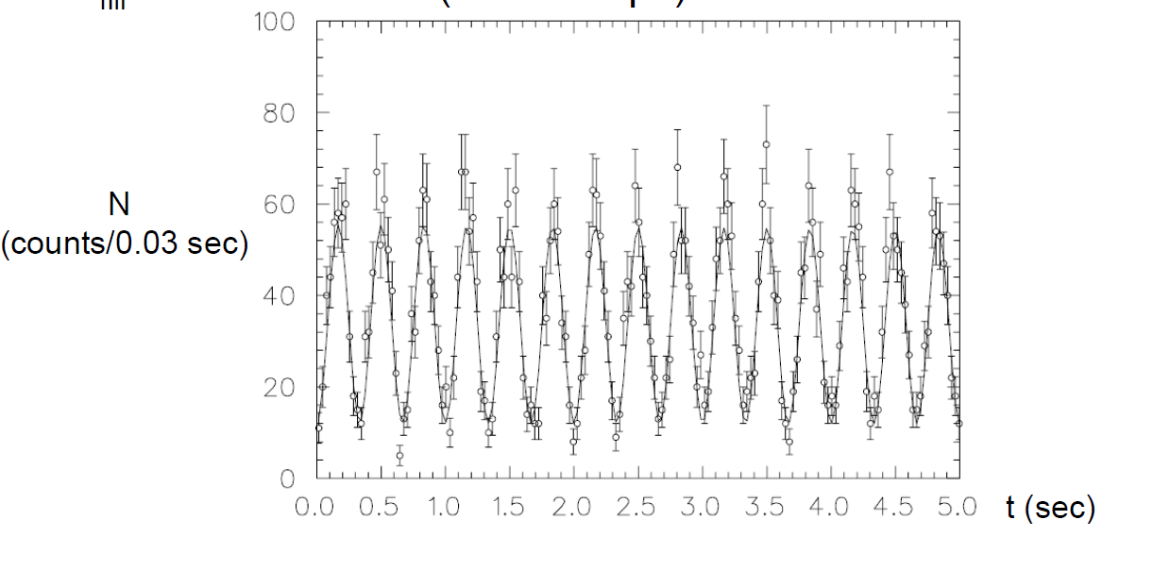
1st = Direct measurement of beat frequency e.g. via spin-dependent neutron capture on polarized ³He capture count rate (measured by LHe scintillation) oscillates at n-³He beat frequency

Slide 52
2nd = “Dressed” Spins
By applying a strong non-resonant AC field, the effective precession frequencies can be modified or “dressed”
For particular values of the dressing field, the neutron and ³He precession frequencies in a plane can be made equal – called critical dressing
If neutron and ³He are critically dressed in zero E-field, then with E-field on and non-zero EDM the spins precess at different at different rates

Slide 53



Critically Dressed Spins
Geometry of B-Fields
$${\vec{B}}_{0}$$
$${\vec{B}}_{AC}$$
Can match effective precession
frequency about B₀ of n ³He

Slide 54
Magnet System for nEDM

Slide 55

Caltech EDM lab (Synchrotron lab next to Lauritsen bldg)
Fluxgate Magnetometer

Slide 56
Status of nEDM@SNS
Recently completed demonstration of critical components (B-fields, HV, polarized 3He)
Beginning large-scale integration of main components (4 yr assembly and commissioning)
Begin data taking in 2023
1 week to reach 2 x 10⁻²⁷ e-cm (10x better than present)
3 yrs to reach 3 x 10⁻²⁸ e-cm

Slide 57
How Low Can We Go?

Slide 58
Extra Slides …

